Slide 1

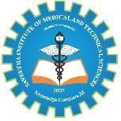
SIMATS ENGINEERING
Saveetha Institue of Medical and Technical Sciences
Chennai - 602105
Cloud-Based Secure Document Management System with Continuous Security Monitoring
CSA5803- DEVSECOPS ENGINEERING
PRESENTED BY SYED SANIYA IQBAL(192465043) MANDA KRUTHIKA REDDY(192465037)
EZHILARASI S (192521187)
GUIDED BY- Dr. R. PITCHANDI

Slide 2
INTRODUCTION
Cloud-based document management enables users to securely store, access, and share documents over the internet from any location.
Protecting sensitive data through encryption, authentication, and access control is essential in modern cloud environments.
Continuous security monitoring helps detect suspicious activities and potential cyber threats in real time.
Integrating security into cloud document management improves data confidentiality, integrity, and availability while reducing security risks.
This project combines secure cloud storage with continuous threat monitoring to provide a reliable and secure document management solution.

Slide 3
LITERATURE SURVEY
Title | Year | Author | Advantage | Disadvantage
Security & Privacy in Cloud Workflows | 2023 | N. Soveizi et al. | Strong cloud security review | No real-time monitoring
Cloud-Based Document Management: Bibliometric Review | 2024 | D. Silva, C. Coutinho | Explains DMS trends | No security implementation
Secure Document Management Systems: A Review | 2025 | F. M. Ozman | Covers encryption & access control | No practical framework
Cloud-Native Security Techniques Survey | 2025 | T. Arif et al. | Covers Zero Trust & cloud security | Not document-specific
Jampile: Secure Cloud File Management Platform | 2026 | J. H. Macapato | Implements RBAC & secure storage | No SIEM or threat detection

Slide 4
PROBLEM STATEMENT
Existing cloud document systems mainly focus on storage rather than continuous security monitoring.
Real-time detection of unauthorized access and cyber threats is still limited.
Many solutions provide encryption but lack integrated threat detection and alerting.
Audit logging and security event analysis are often insufficient for rapid incident response.
A unified secure document management system with continuous monitoring is needed to improve cloud security.

Slide 5
OBJECTIVES
To establish a zero-trust environment for secure document access in the cloud.
To safeguard sensitive documents using encryption and role-based authorization mechanisms.
To enable continuous security monitoring for proactive identification of suspicious activities.
To automate threat detection and alert generation for rapid incident response.
To build a resilient cloud document management system by integrating DevSecOps security practices throughout the application lifecycle.

Slide 6
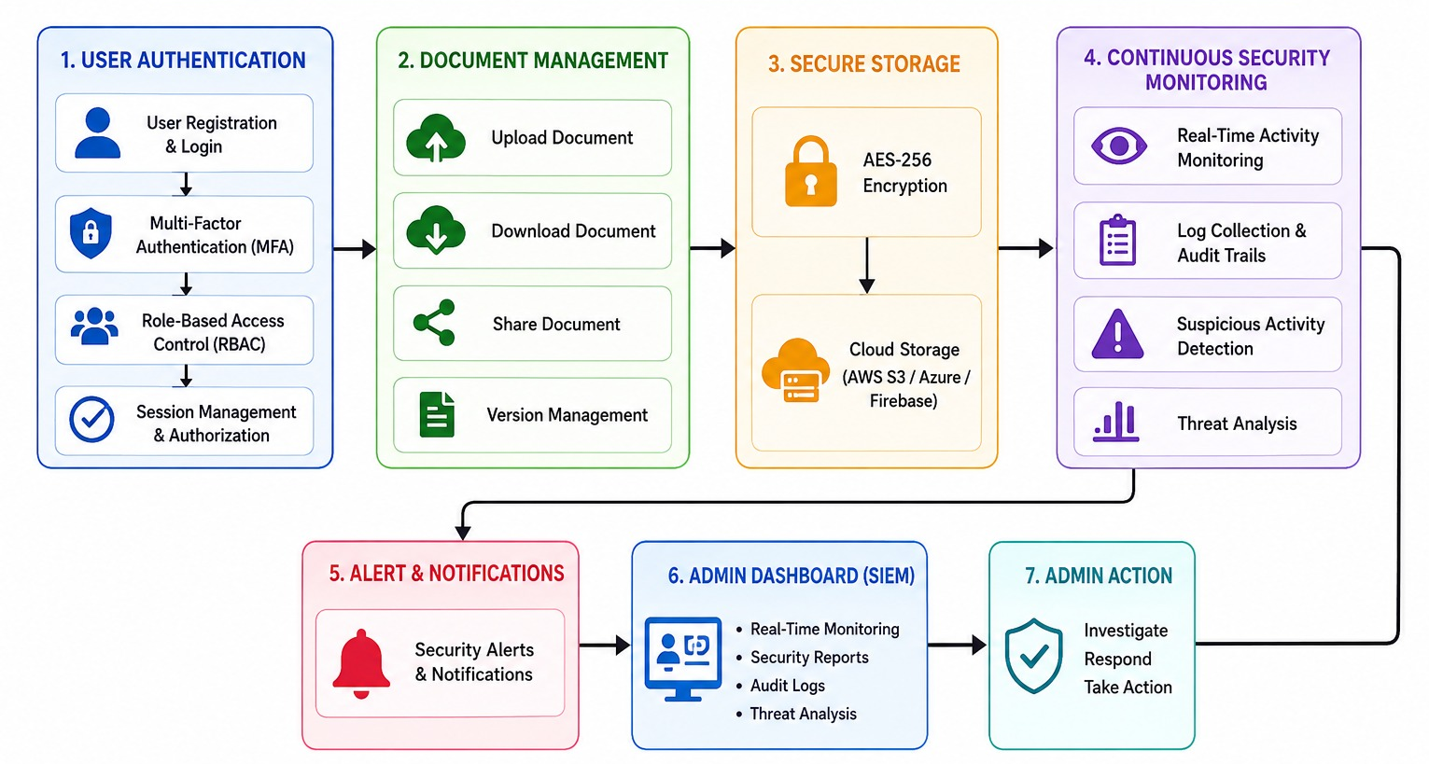
SYSTEM ARCHITECTURE

Slide 7
MODULES
Module 1: Secure User Authentication and Access Control
Module 2: Secure Cloud Document Management
Module 3: Continuous Security Monitoring and Threat Detection

Slide 8
MODULE 1 Secure User Authentication and Access Control
User Registration: Users create an account by providing valid credentials, which are securely stored in the database.
Secure Login: The system verifies user credentials before granting access to prevent unauthorized entry.
Role-Based Access Control (RBAC): Different user roles (Admin, Manager, User) are assigned specific permissions based on responsibilities.
Session Management: Secure user sessions are maintained using tokens, with automatic logout after inactivity.
Authorization & Access Control: Only authenticated and authorized users can access, modify, or share cloud documents.

Slide 9
MODULE 2
Secure Cloud Document Management
Secure File Upload & Download: Users can safely upload and retrieve documents through encrypted communication channels.
AES-256 Document Encryption: Documents are encrypted before storage, ensuring data confidentiality even if storage is compromised.
Cloud Storage Integration: Encrypted documents are securely stored using cloud platforms such as AWS S3, Azure Blob Storage, or Firebase Storage.
Secure Document Sharing: Files can be shared only with authorized users while maintaining access restrictions.
File Version Management: Previous versions of documents are maintained to support recovery and change tracking.
Document Integrity & Availability: The system ensures documents remain protected, accurate, and accessible whenever required.

Slide 10
MODULE 3
Continuous Security Monitoring and
Threat Detection
Real-Time Activity Monitoring: Every login, upload, download, and sharing action is continuously monitored.
Log Collection & Audit Trails: System activities are recorded to maintain a complete history for security audits and compliance.
Suspicious Activity Detection: The system analyses user behaviour to identify unauthorized access attempts or abnormal activities.
Security Alerts & Notifications: Automatic alerts are sent to administrators when potential threats or policy violations are detected.
SIEM-Based Threat Analysis: Security events are analysed through a centralized dashboard for faster threat investigation.
Incident Response & Reporting: Security reports help administrators respond quickly, reduce risks, and improve overall system protection.

Slide 11
FUTURE SCOPE
AI-Based Threat Detection and Predictive Security Analytics
Blockchain-Based Audit Logging for Enhanced Data Integrity
Biometric Authentication Using Fingerprint and Facial Recognition
Mobile Application for Secure Document Access and Management
Automated Incident Response with Advanced SIEM Integration
Real-Time Risk Assessment and Continuous Compliance Monitoring

Slide 12

CONCLUSION
The Cloud-Based Secure Document Management System with Continuous Security Monitoring provides a secure and efficient platform for storing, accessing, and sharing documents in the cloud.
The system integrates user authentication, role-based access control (RBAC), AES-256 encryption, and secure cloud storage to protect sensitive information..
By incorporating DevSecOps principles, the solution enhances the confidentiality, integrity, and availability of documents while ensuring a scalable and reliable cloud environment.
Overall, the proposed system offers a comprehensive approach to secure document management and strengthens organizational cybersecurity against modern threats.

Slide 13
THANK YOU

